Slide 1
Pattern Recognition Assignment
Team 30
Antonios Antoniou 9482
Konstantinos Kalamaras 9716

Slide 2
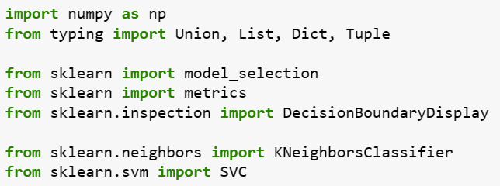
Introduction and libraries
First of all , we import numpy and sklearn libraries in addition to some of their modules , in order to : implement classification methods(SVC & KNeighborsClassifier) , measure classification performance (metrics) , split data into two sets (model_selection) etc.

Slide 3
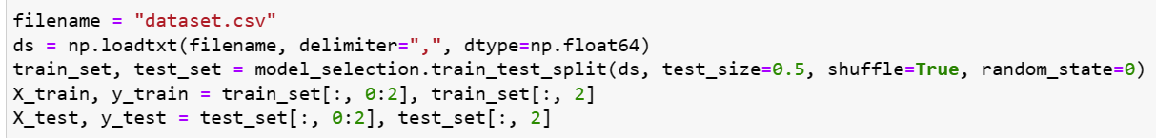
Then , we load our data and split it into two sets (training and testing). Finally , we divide each of those sets into their two parts , the features and labels(the last column).

Slide 4
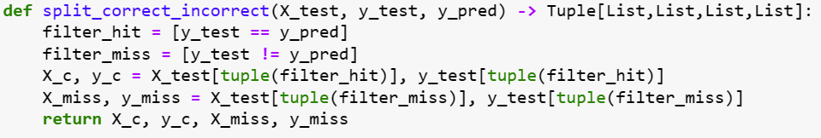
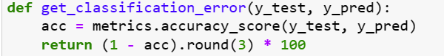
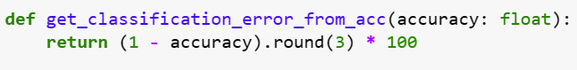
Generally used functions
Firstly, we create the split_correct_incorrect , to split the classified datapoints into two categories: correctly placed and misclassified ones.
We also create two functions : get_classification_error , get_classification_error_from_acc , to calculate the classification error using the accuracy score(pre-computed or not).

Slide 5
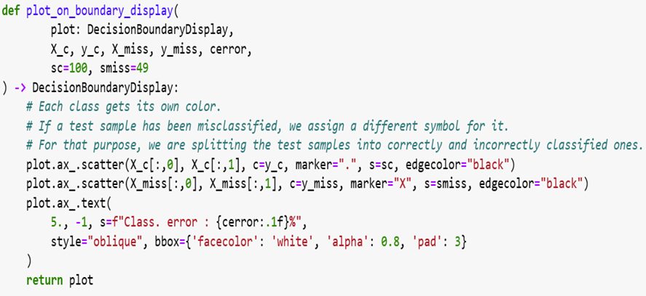
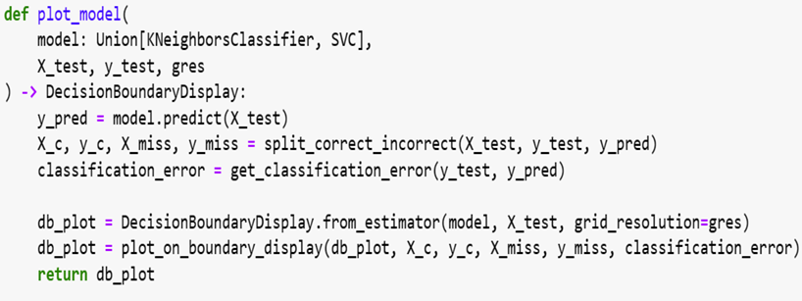
Afterwards, we create two main functions to achieve the plot of our datapoints in every question. The first one (plot_on_boundary_display), targets to split points into different colored decision boundaries and differentiate the symbolism of correctly and misclassified datapoints. The second one (plot_model), calculates the prediction of a model on the test data, plots the decision boundary and the distribution of the datapoints.

Slide 6
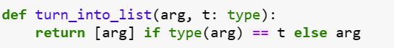
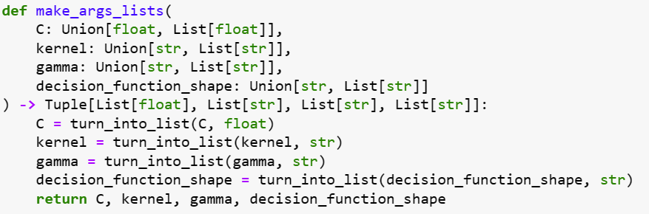
Those two last generally used function's goal is to turn all the required data into lists or check if they already are in the correct form. In more detail , the turn_into_list function takes an argument of a certain type and checks if it is a single value or a list of values. If we talk about a single value , it is transformed into a list of size 1, otherwise the argument is returned intact. The make_args_list , takes advantage of the previous function , to turn a whole list of arguments into individual lists , so as to make the iteration over all of them possible.

Slide 7
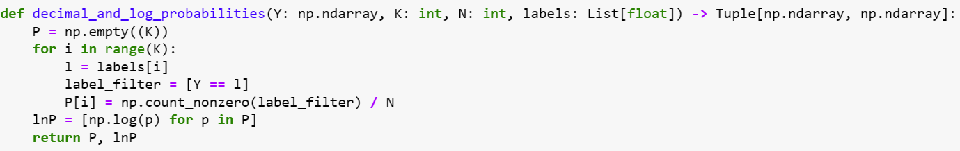

Question a bayes classifier
In this first question , we are asked to implement the Maximum Likelihood technique to create a Bayes Classifier. The first function we make , is the one that calculates the probabilities of the occurrence of each class , together with their natural logarithm , as the ML Theory demands : P = $p\left(D | θ\right)= \prod_{n=1}^{N}{p(x_{n}|θ)}$ and lnP = $l\left(θ\right)=ln⁡\prod_{n=1}^{N}{p(x_{n}|θ)}$.
Note : We have already divided our data into training and test sets in the introduction code.

Slide 8
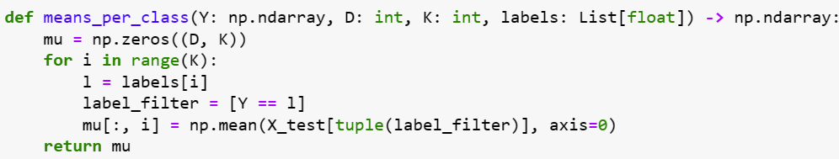
Subsequently , we create the means_per_class function , targeting the creation of a statistical board that contains the means of some valuable features. Each row of the returned matrix contains the mean of a feature for each class. On the other hand , each column consists of the means for all features of one class.

Slide 9

In more detail , in this question we are expected to create a Bayes Classifier for two different cases : 1) assuming that all classes have the same covariance table and 2) assuming that every class has a different covariance table.
As our theory indicates , taking into account that we are dealing with a normal distribution , the discriminant function’s , we are using to classify our data , general form is :
$$g_{i}\left(x\right)=\frac{−1}{2}{{\left(x−μ_{i}\right)}^{t}Σ_{i}^{−1}\left(x−μ_{i}\right)−\frac{d}{2}\ln\left(2π\right)−\frac{1}{2}ln\left|Σ_{i}\right|+lnP\left(ω_{i}\right) }^{}$$

Slide 10
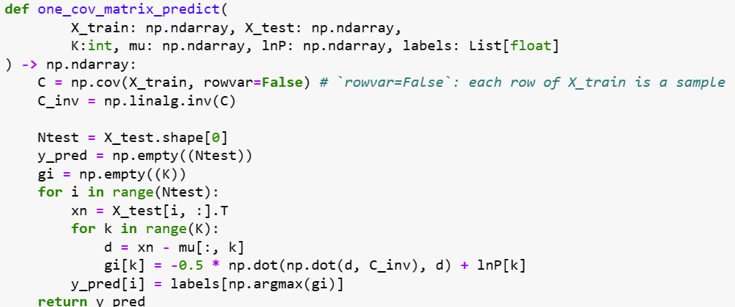

Dealing with the first case (same covariance table) , we create the one_cov_matrix_predict , to help us classify our datapoints. Now , our samples fall in a hyper-ellipsoidal clusters of equal size and same shape centered about the mean vector $μ_{i}$ and the discriminant function is simplified into :
$$g_{i}\left(x\right)=\frac{−1}{2}{{\left(x−μ_{i}\right)}^{t}Σ_{i}^{−1}\left(x−μ_{i}\right)+lnP\left(ω_{i}\right) }^{}$$

Slide 11
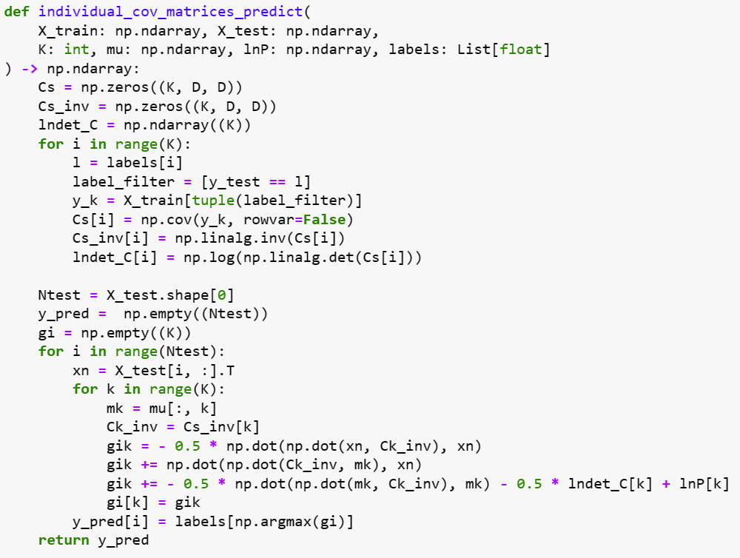

Moving on to the second case (different covariance tables) , we create the individual_cov_matrices_predict , to help us classify our datapoints. In this case , the decision surfaces are hyperquadrics and get any of the general forms, e.g. , hyperplanes, hyperspheres, hyperellipsoids etc. and the discriminant function has a form :
$$g_{i}\left(x\right)=\frac{−1}{2}{{\left(x−μ_{i}\right)}^{t}Σ_{i}^{−1}\left(x−μ_{i}\right)−\frac{1}{2}ln\left|Σ_{i}\right|+lnP\left(ω_{i}\right) }^{}$$

Slide 12
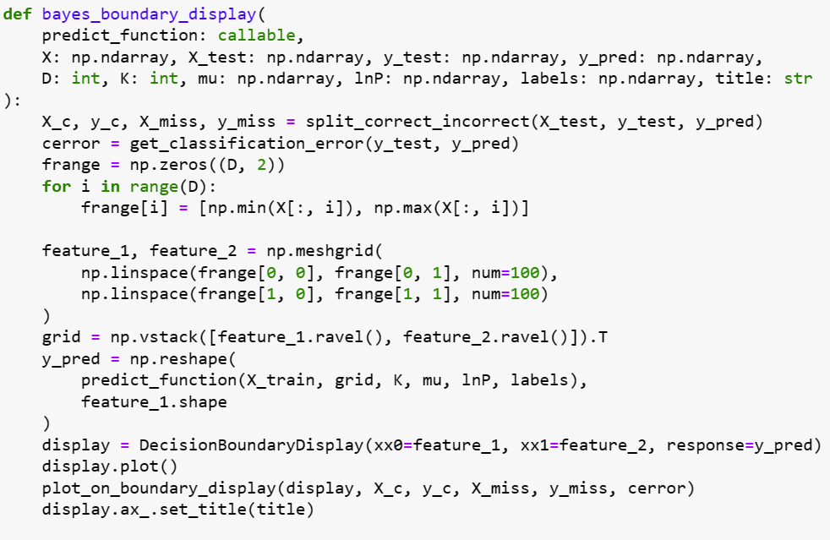
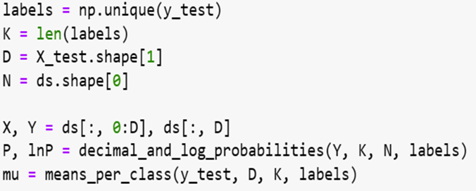
The last function we create in this question , is the bayes_boundary_display. The aim of this function , is to make a display of the decision boundaries of our bayes classifier , using the callable classifier predict_function to make predictions on the X_test. Additionally , it scatters the correctly and incorrectly classified points in our display and notes the classification error that is computed.
Moving to the implementation and visualization of this question , we start by extracting some valuable data , such as : K : number of classes , D : dimension of samples , N : number of total samples and computing the statistical features we talked about in the first two slides of this question (P , lnP , means).

Slide 13
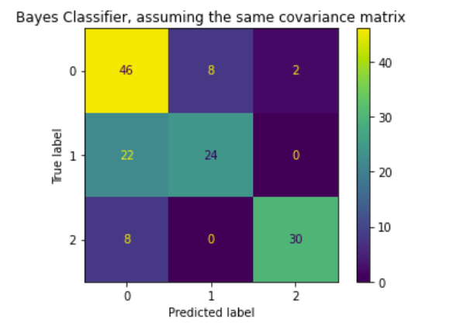
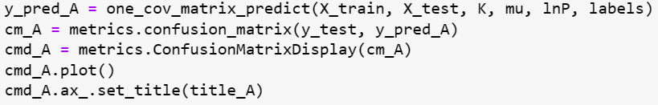
Same covariance
Assuming that all classes have the same covariance table C , we calculate this table using the one_cov_matrix_predict function for our training data and then take advantage of the metrics library , to plot the confusion matrix of this classifier.

Slide 14
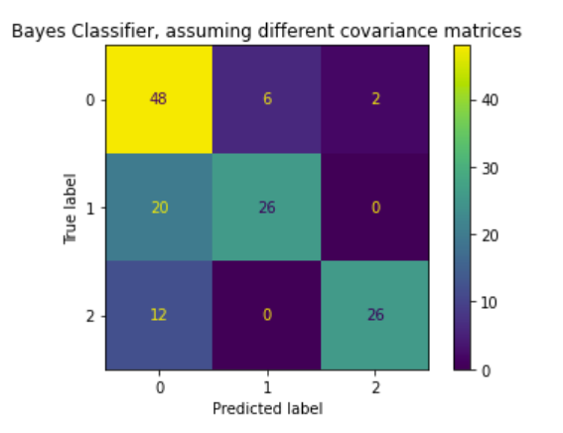
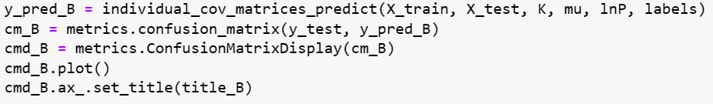
Different covariances
Same as in the previous slide , we generate a confusion matrix for the Bayes Classifier that assumes that every class has a different covariance matrix , this time using the individual_cov_matrices_predict function.

Slide 15
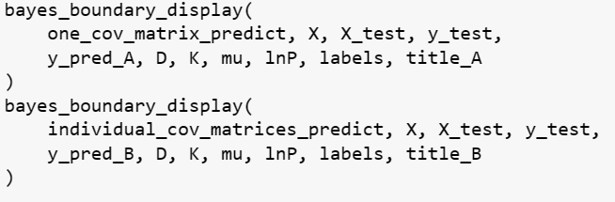
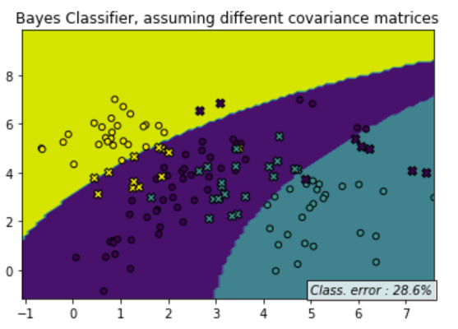
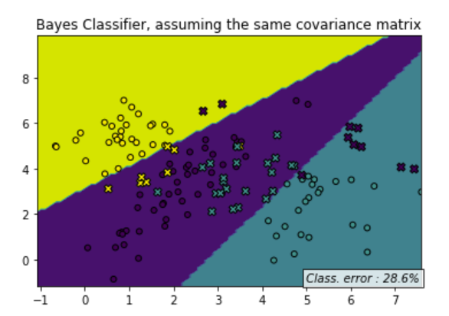
Results and conclusion
Our final move in this question , is to call the bayes_boundary_display function for both occasions and thus generate displays of the Decision Boundaries , with the misclassified datapoints being marked.
A general conclusion we can make , is that while the decision regions are different (of different shape but around the same bounds), and less linear in the case where we consider different covariance matrices for each class, we can see that the nature of the dataset doesn't allow for the benefits of a non-linear classifier. What we are left with is a more flexible classifier, that makes the same error as its linear counterpart.

Slide 16
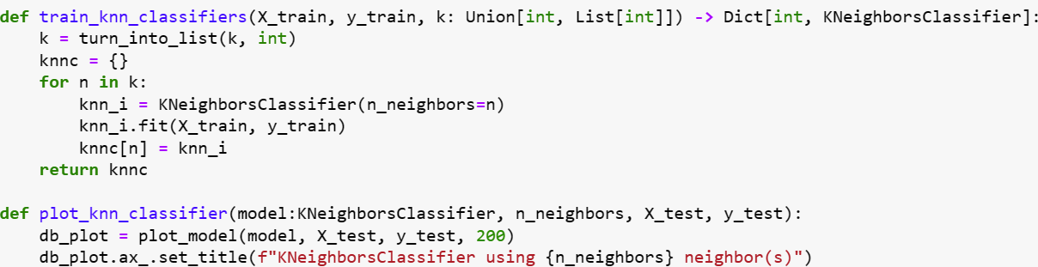
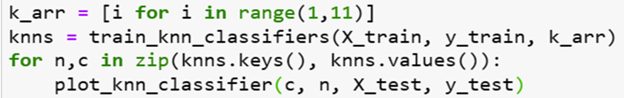
Question b k-Nn classifier for I = (1 … 10)
In this question , we start by creating a training function that takes a list of our data and accordingly to the number of neighbors we want to train our model upon , creates KNeighborsClassifiers and returns a Dictionary of classified data.
After that , we make the plot_knn_classifier function by using the previously created and explained plot_model function , in order to visualize the classification results for each number of neighbors we want to use.
Finally , we implement those two previously created functions for every number of neighbors between 1 and 10(as asked). The result is ten different classification diagrams , showing the number of neighbors used, the classification areas and the classification error in each case.

Slide 17
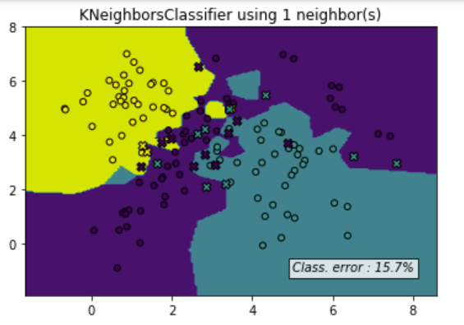
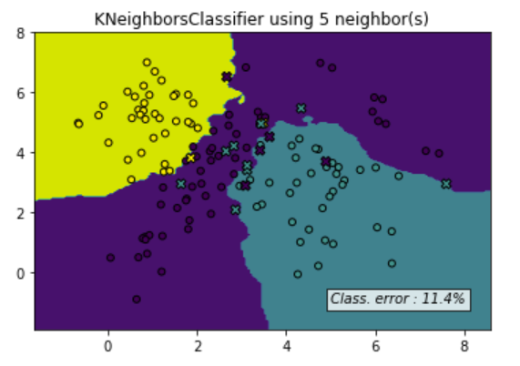
best vs worst classifier
Here, we present the best and worst case classifier scenarios , based on the classification error percentage. The best case , is the classifier that uses 5 neighbors with a classification error of 11,4 %. On the other hand , the worst case is the classifier that uses 1 neighbor with a classification error of 15,7 %.
The reason behind this fact , is that we have samples of different classes very close to each other , thus requiring more neighbors to achieve a more precise classification result.
However , as we’ll see in the next slide there is a limit in the number of neighbors we can use in order to maximize our classification efficiency.

Slide 18
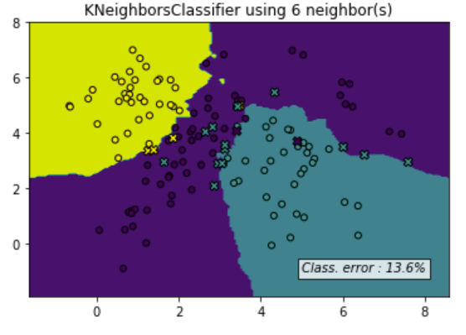
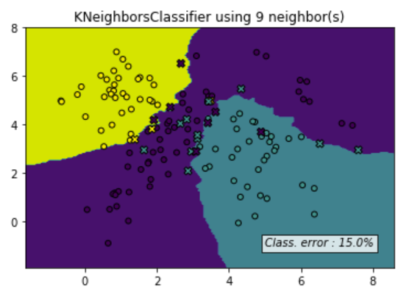
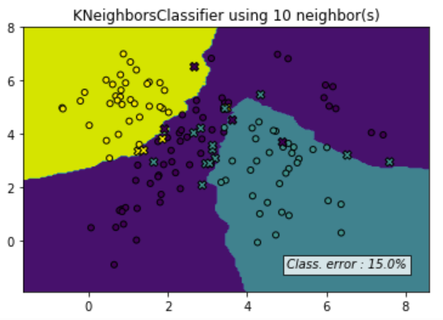
performance plateau
As we mentioned before , the classification efficiency does not always increase together with the number of neighbors that are used. Those pictures show that , after reaching the minimum classification error for the 5-neighbor case , the error starts to increase , before being stabilized after the 9-neighbor case.

Slide 19
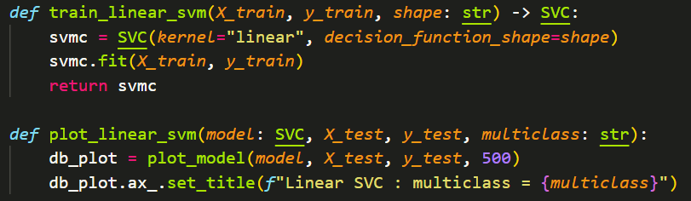
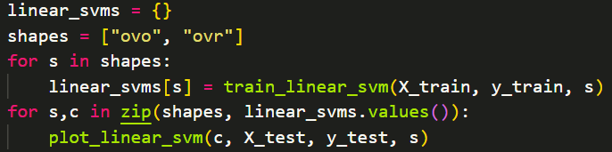
Question c linear SVm classifier
In this question , we are dealing with the creation of a linear SVM classification model , using two different implementation methods : one-vs-one(ovo) and one-vs-rest(ovr). First of all , we create the two functions shown in the top of this slide , one to train the linear svm classifier (using the sklearn function SVC) and the other one to visualize the results of the classification (using the previously created plot_model function).
After that, we are ready to call those functions for our two different shape types (ovo and ovr).

Slide 20
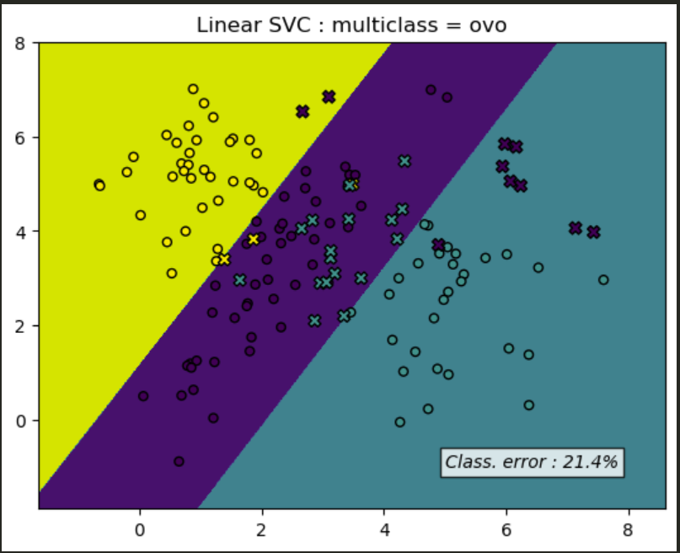
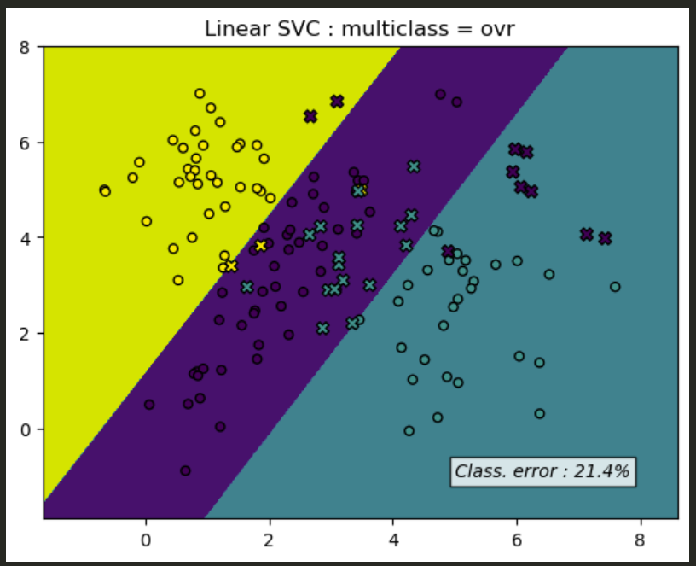
In more detail , about the two Multi-Class Classification methods we use , we can say that :
One-vs-rest, involves splitting the multi-class dataset into multiple binary classification problems. A binary classifier is then trained on each binary classification problem and predictions are made using the model that is the most confident.
Unlike one-vs-rest that splits it into one binary dataset for each class, the one-vs-one approach splits the dataset into one dataset for each class versus every other class.
Despite the fact that, the results shown in this slide are generated using those two different methods for the linear SVC case , we conclude that there are not any differences in them.

Slide 21
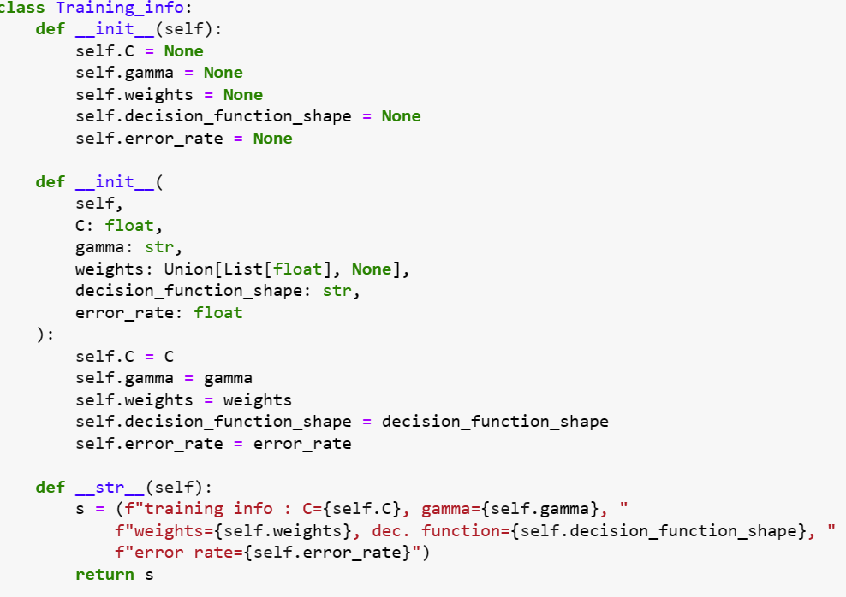
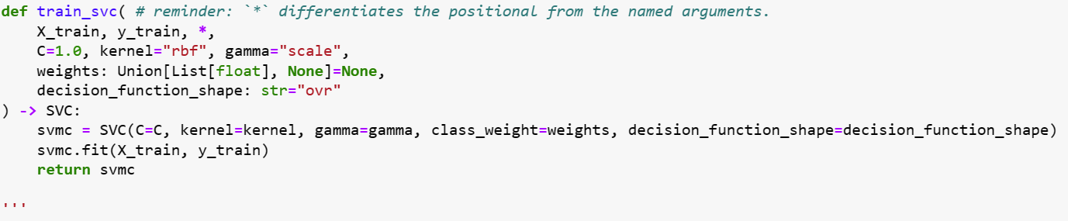
RBF KERNEL SVM CLASSIFIER
Moving forward , we now have to deal with the implementation of an RBF Kernel SVM Classifier. Our general plan in this question, is to generate a grid search algorithm that will help us train and use the classifier with the best metrics , accordingly to the values of some hyperparameters (C, gamma, class weight, decision function shape). First of all , we start by generating the Training_info class which will keep the hyperparameters used to train the best classifier, when grid search is executed. Then, we create the training function (train_svc) in the same way we did in the linear SVM case (using the sklearn function SVC) , but with an rbf kernel and more hyperparameters used .

Slide 22
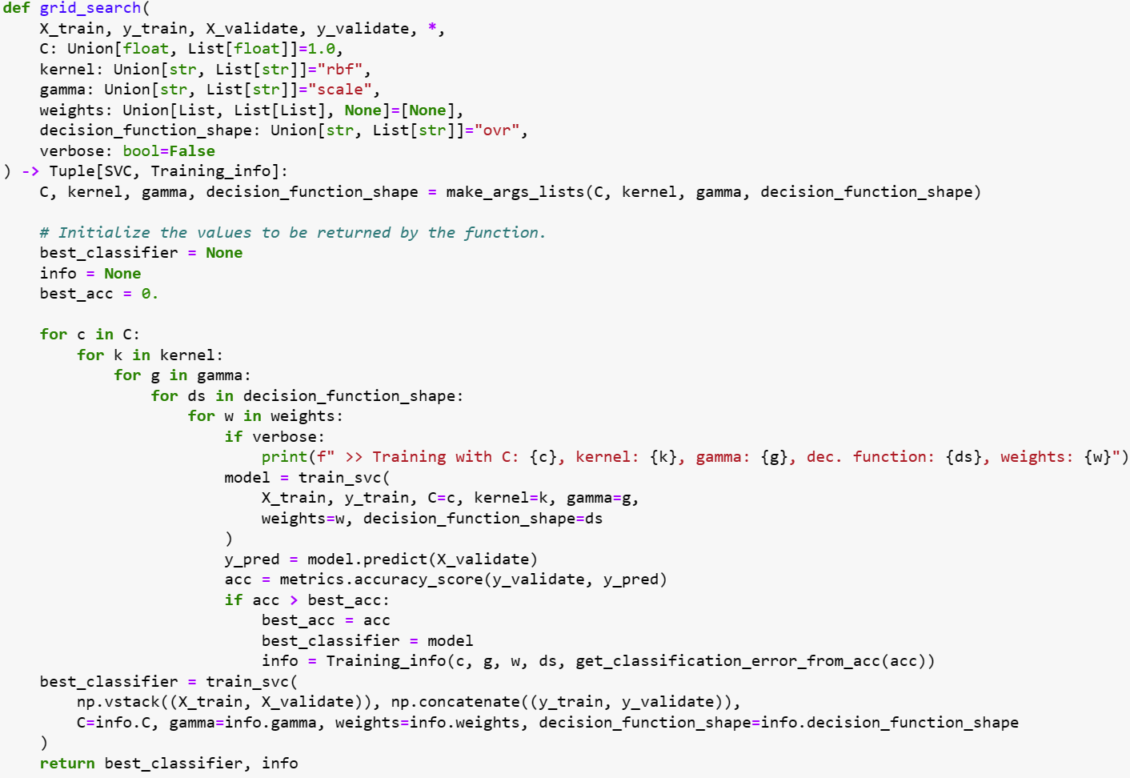
Proceeding , we implement the grid search we talked about in the previous slide. In order to determine which are the optimal parameters for our classifier , then report on its misclassification rate , we split the testing set into two : The validation set and the final testing set. We test each classifier created during grid search using the validation set , then the best model is re-trained utilizing a concatenation of the training and validation data. The held-out testing set is ultimately used , in order to get a final sense of the resulting classifier’s accuracy.

Slide 23
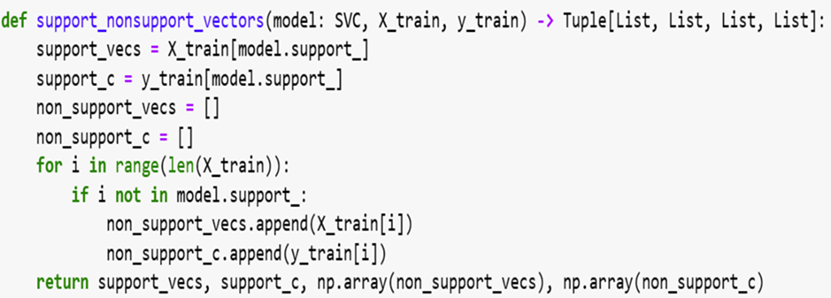
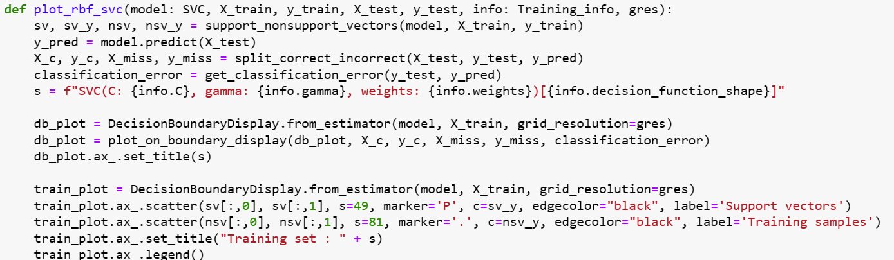
Afterwards, we create a simple function to split the training datapoints into support and non-support vectors and we return them together with the corresponding classes. Finally, the last function we create in this question is the one that plots the model’s training datapoints, with the support vectors being plotted distinctively. Then , it creates a plot like the previous ones , which distinguishes the correctly and improperly classified datapoints
and reports on the classification error rate on the bottom right.

Slide 24
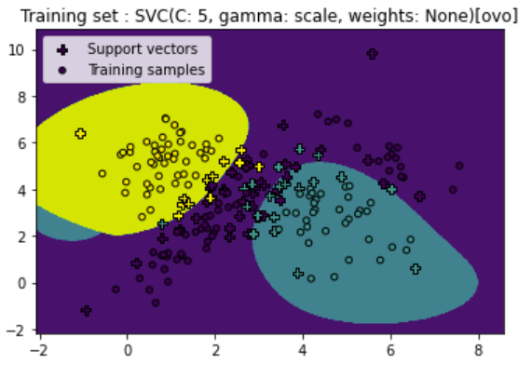
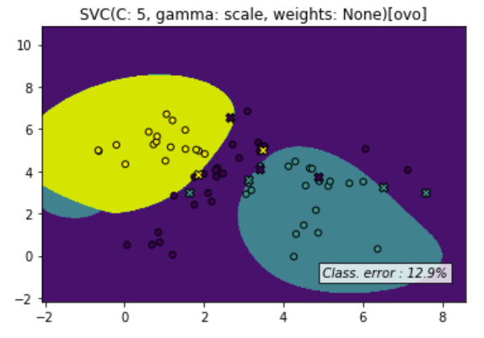
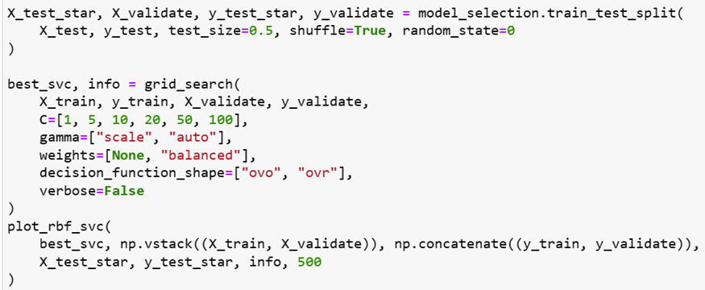
Results
We see that we generate a grid search for some different hyperparameter’s values , in order to find and then plot the best svc model, with discrete symbolism for the train sets , the support vectors , the test sets and the improperly classified datapoints as asked.

Slide 25
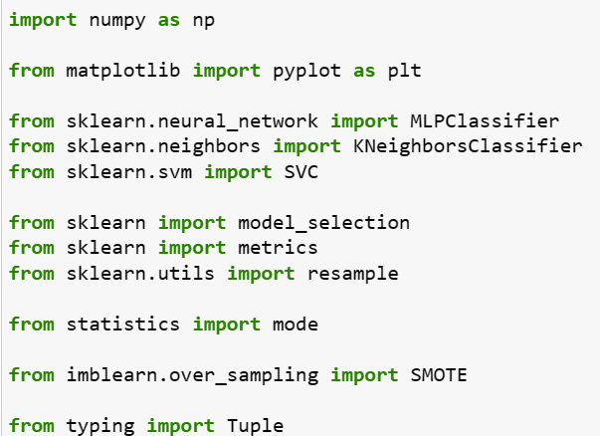
Question d custom classifier
First of all, we start again by importing all the necessary libraries together with some of their modules to help us : implement classification methods (MLPClassifier , SVC , KNeighborsClassifier) , plot (pyplot) and measure (metrics) classification results, split data into sets (model_selection) and deal with imbalanced datasets (resample, SMOTE) etc.

Slide 26
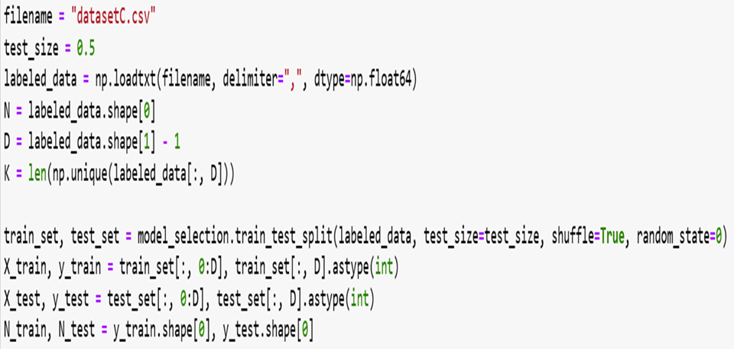
After that, we load out data from the “datasetC.csv” file and we split them into the training set (consisted of N samples) and the testing-validating set.

Slide 27
In this question , we are asked to create our own classification algorithm , to achieve the best classification ratio. For this reason , we are going to experiment on multiple classification techniques , in order to find the best one. The techniques we ended up testing are :
1) MLP
2) K Neighbors Classifier
3) SVC

Slide 28
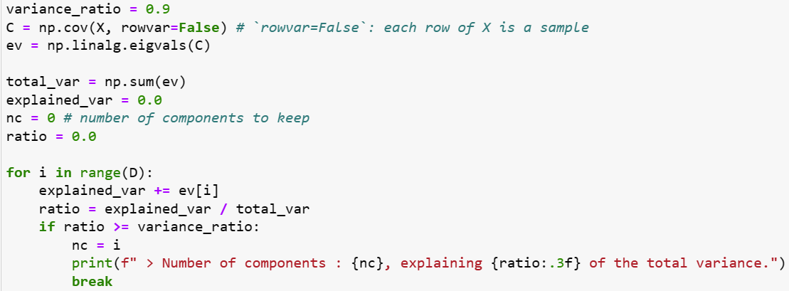
Pca testing
We start our tests , by checking if we could take advantage of the Principal Component analysis , in order to reduce the size of our dataset without losing any important information about it. We chose to check how many components we have to keep , in order to maintain 90% of the explained variance. The number that comes up is too high (350 out of 400) to bother transforming our data. The reason behind this big number , is that the explained variance is equally distributed amongst almost all features.
So, we have no concrete way to visualize the data.

Slide 29
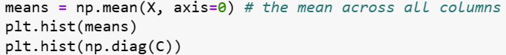
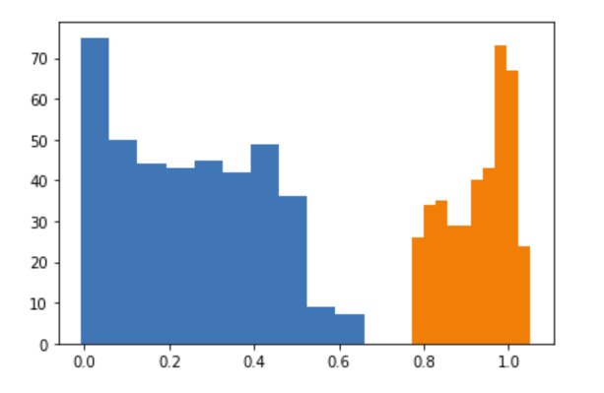
Scaling testing
Now , we are going to check whether we can improve our data by scaling or normalizing it. So , we will check the means and variances of all features by using the hist function of the matplotlib library , to create a histogram. The histogram that comes up and can be seen in this slide , shows that all features are in the same order of magnitude and thus no scaling needs to be done.

Slide 30
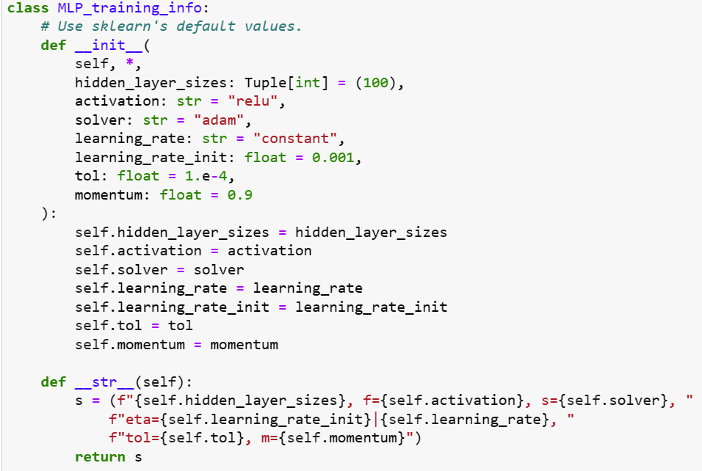
Mlp testing
Moving on , we are going to test the performance of an MLP Classifier to our task. We start by creating a class like the one we used in question C , in order to store information on the hyperparameters that will prove to be the best after a typical grid search.

Slide 31
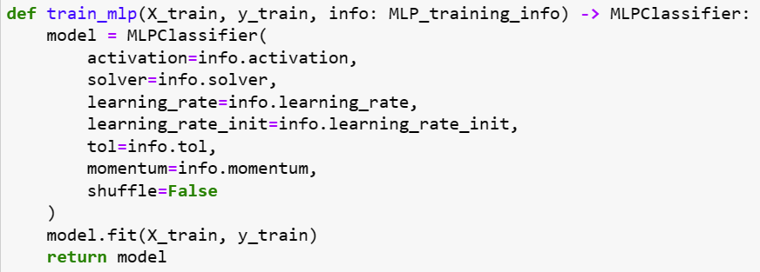
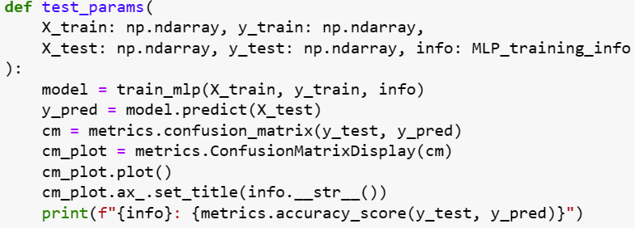
Then , we continue by creating two functions : the train_mlp and the test_params , that will help us carry on the MLP tests. The first one , uses the custom MLP training parameter class in order to pass the values
to sklearn's MLPClassifier module. The second one , trains an MLP using the parameters stored in info (object of the class we use in our tests) ,
displays the confusion matrix and the accuracy of the model,
along with the utilized parameters.

Slide 32
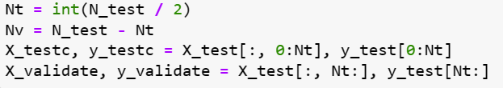


Finally , before starting our tests , we split the testing dataset into two equal parts. The first half , remains the testing data and the second half will be used for validation.
Then , we create an object of the MLP_training_info class called info (as we mentioned in the previous slide) and we experiment by changing some of the hyperparameter’s values to see how the classification goes.

Slide 33

K neigbors classifier testing
The next classification approach that we applied , is the K-Neighbors Classifier. As we see in this picture , we implemented this method for various values of K and we gathered the confusion matrices and accuracy scores for each case.

Slide 34

Svm testing
Progressing , we are also trying to use an SVC Classifier on our data. We try several SVC cases , all of them with an rbf kernel and some of them after implementing SMOTE to tacke any possible imbalance in our dataset. We generate and compare the confusion matrices and accuracy scores of each case.

Slide 35


Resample testing
The last test we are conducting , is to train a number of 2*K (K is the number of classes in the dataset) classifiers using resampling.

Slide 36

results
After all those different methods that we tried , the best accuracy score we get is 0.8456 and it comes with an SVC Classifier with rbf kernel and c = 10.
However , in order to be sure that we achieve the maximum accuracy score possible , we will conduct a final grid search around the neighborhood of the best value for C. After using the validation set for our search , we conclude that the best C is 8.0 with an accuracy score of 0.848.

Slide 37



Now , we just have to create this optimal SVC Classifier (kernel = ‘rbf’ , C = 8) and generate its confusion matrix for the validation data.

Slide 38

Last but not least , we predict the values for datasetCTest.csv and store them in a .npy file , names “labels30.npy” , as asked in this question.

Slide 39
Thank you so much for your attention

